Slide 1
Storage Technology Trends & Product Evolutions 2024

Slide 2
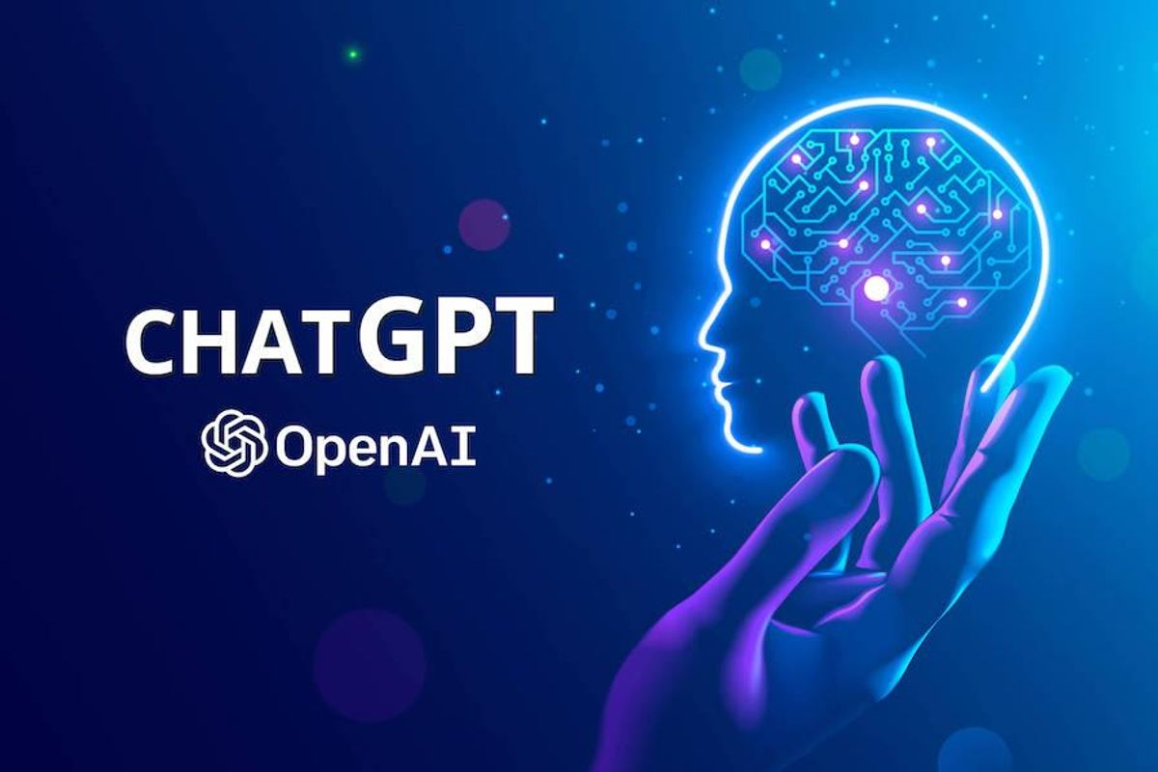

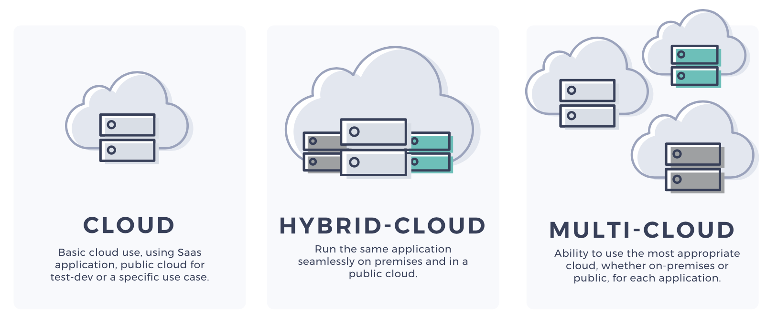

Hot Trends 2023
Notes:
What is hot in the technology circle:
ChatGPT, Ransomware, Metaverse, Blockchain & NFT, multi-cloud
Next let us see what Gartner says

Slide 3
Competitive Landscape
AI/ML Infrastructure
Ransomware Protection
Disaggregated Composable
Big Data Analytics
Hybrid Multi-Cloud
Product Evolutions
Notes:
Highlight: these are the most relevant technology to data centers.

Slide 4
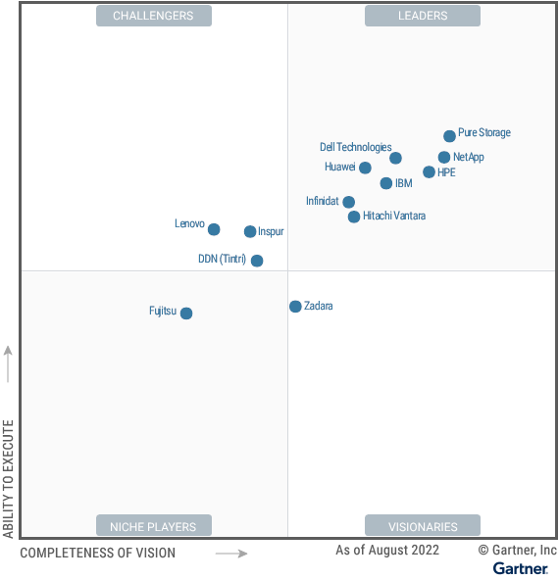
Competitive Landscape – Primary Storage
Pure Storage
QLC DFM, secondary storage
A/P dual controllers, vs SATA HDD storage
Dell EMC
HCI (VxRail, PowerFlex)
Losing VMware
NetApp
QLC SSD, ASA (All SAN Array)
Cloud storage services not growing
HP Enterprise
OEM VAST Data, Scality
Own branded products
Source: Gartner 2022 Primary Storage

Slide 5
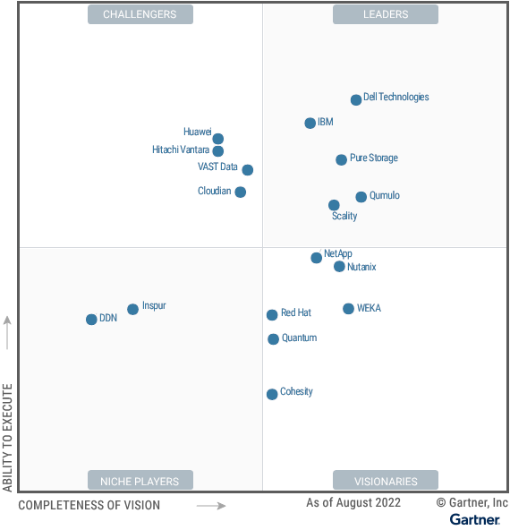
Competitive Landscape – Distributed File & Object
Dell EMC
ECS (costs, eco), PowerScale (features)
High performance for AI/ML
Pure Storage
QLC DFM, active archive
High performance for AI/ML
VAST Data
Read bandwidth, QLC, data efficiency
IOPS, write performance
WEKA, DDN, IBM
Read and write bandwidth
Data reduction and efficiency
Source: Gartner 2022 Distributed File & Object

Slide 6
Competitive Landscape
AI/ML Infrastructure
Ransomware Protection
Disaggregated Composable
Big Data Analytics
Hybrid Multi-Cloud
Product Evolutions
Notes:
Highlight: these are the most relevant technology to data centers.

Slide 7
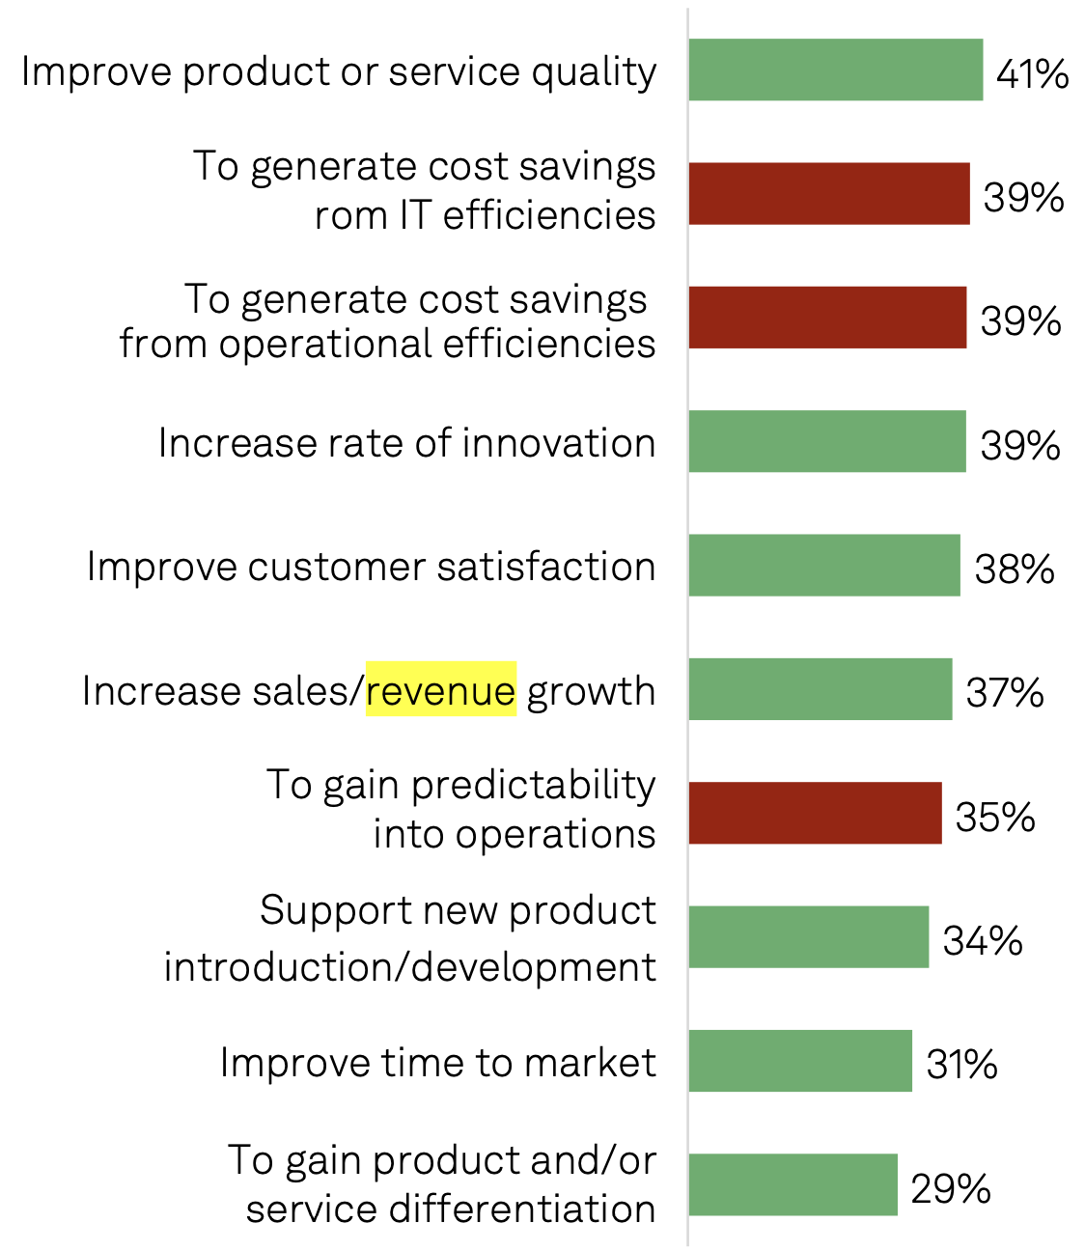
Artificial Intelligence Market Trends
AI has shifted from a costing saving measure to a revenue driver
Top challenges: data management, security, compute power
Legacy data infrastructures directly impact AI adoption and performance
Organizations with modern data infrastructure will lead in the AI race
Source: 2023 Trends in AI Report, S&P Global

Slide 8
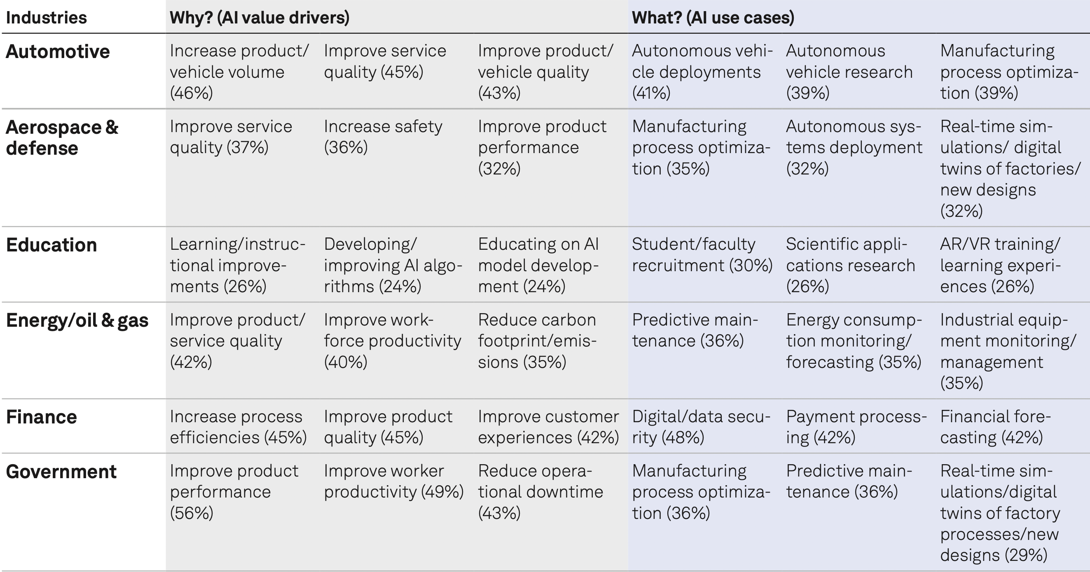
AI Value Drivers and Use Cases
Source: 2023 Trends in AI Report, S&P Global

Slide 9
AI/ML Terminalogy
Artificial Intelligence
Machine Learning
Generative AI
Foundation Models
Large Language Models
GPT
LLaMA
Custom Models

Slide 10
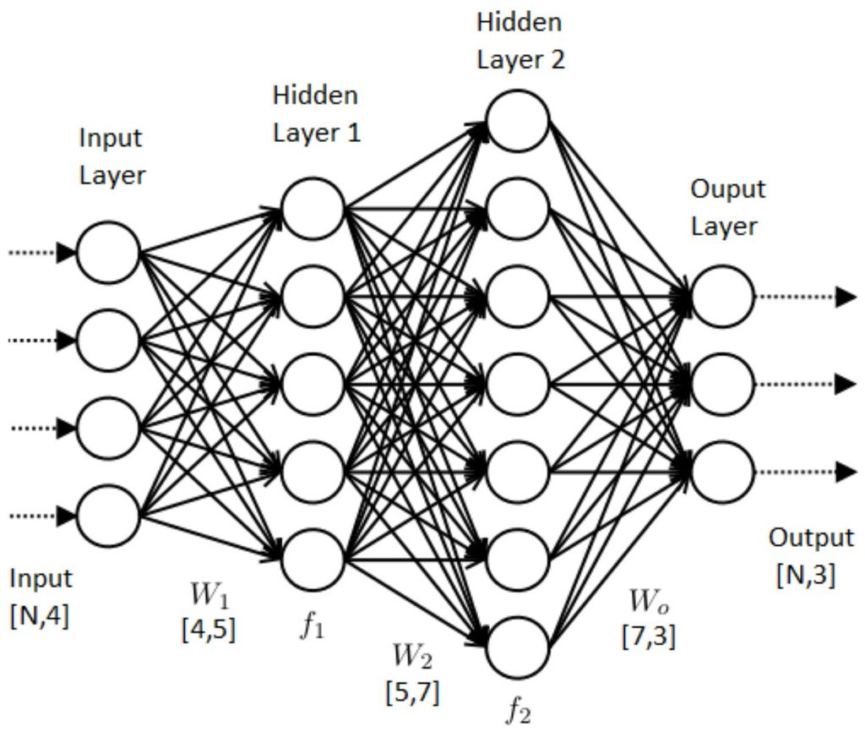

Artificial Neural Networks
Target
Loss
Gradient
Output
Function
Descent
Back Propagation

Slide 11
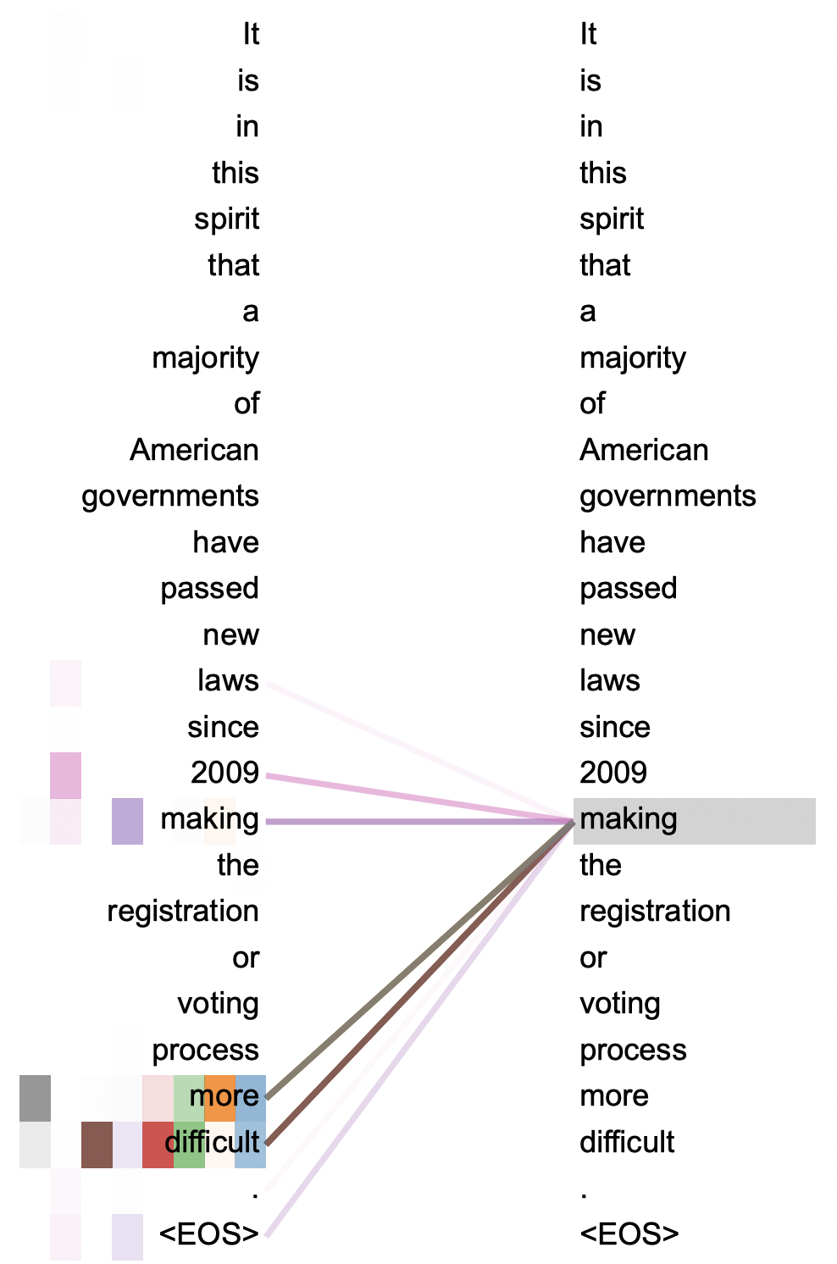
Transformers: Attention Is All You Need
Recurrent Neural Networks
Sequential processing
Local dependencies
Unidirectional
Transformer Neural Networks
Parallel processing
Global attentions
Bi-directional

Slide 12
Large Language Models
GPT-3.5
175 billion parameters
Text only, 500 billion tokens
45TB dataset
ChatGPT and APIs/$
LLaMA
65 billion parameters
Text only, 1.4 trillion tokens
126TB dataset
Open source
GPT-4
500 billion parameters
Text, code, images
ChatGPT+/$ and APIs/$$$

Slide 13
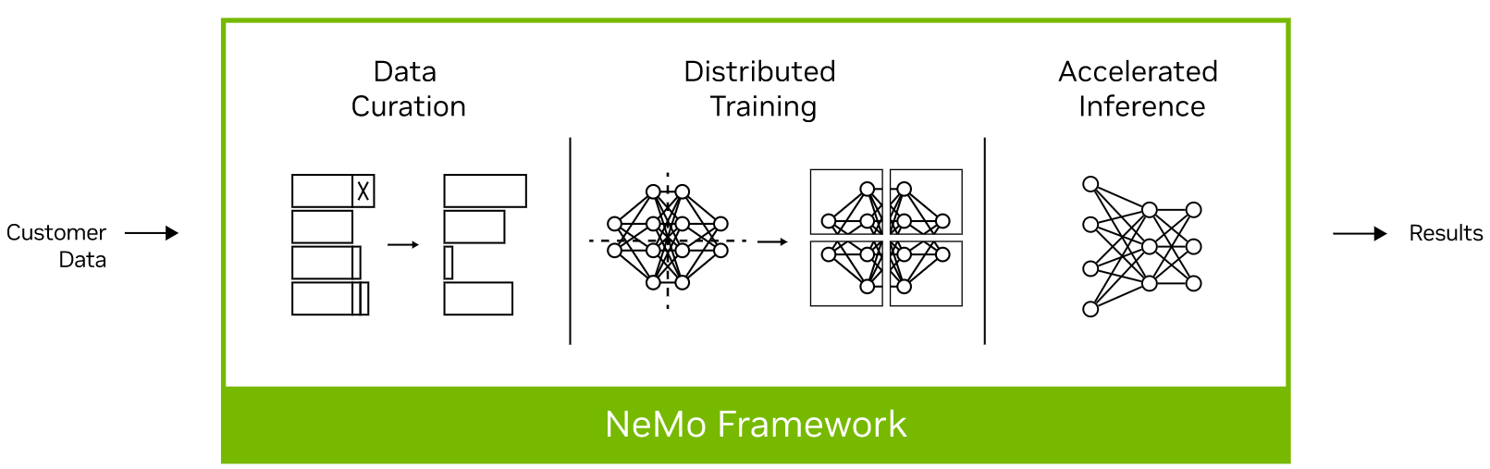
Enterprise-Ready, Private AI
Data Curation
Filter, select
De-identify, sanitize
Instructions
Fine Tuning
Classic
Parameter efficient
Supervised
Inference
Edge and DC
Efficient footprint
Performance

Slide 14
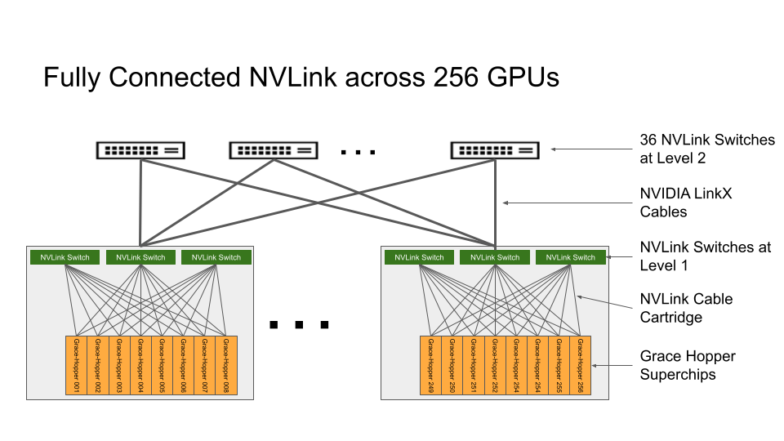
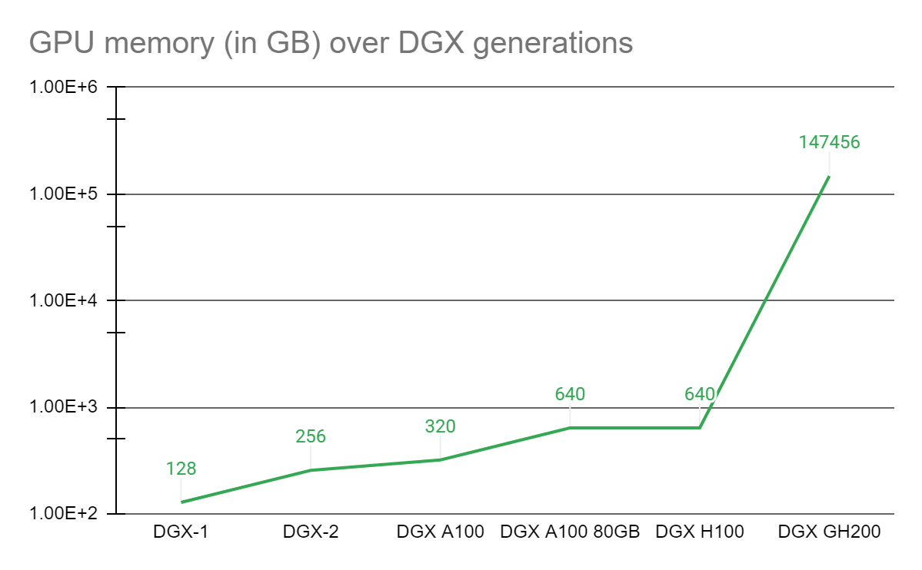
NVIDIA Compute Infrastructure
DGX A100 & H100 (32 petaFLOPS)
80GB per GPU, 8x80GB via NVLink
Multiple DGX systems via IB
DGX GH200 (1 exaFLOPS)
576GB per GPU-CPU pair
147TB via NVLink across 256x systems
AI storage needs to be fast enough to saturate GPUs

Slide 15

Case Study: Meta AI Research SuperComputer
Use Cases
NLP, computer vision, speech recognition
Compute Hardware
2,000 DGX A100, 16,000 GPUs, 200G IB
Storage Hardware
500PB QLC bulk storage
80PB local NVMe cache storage
AirStore Software
Prefetch from bulk storage to local cache

Slide 16
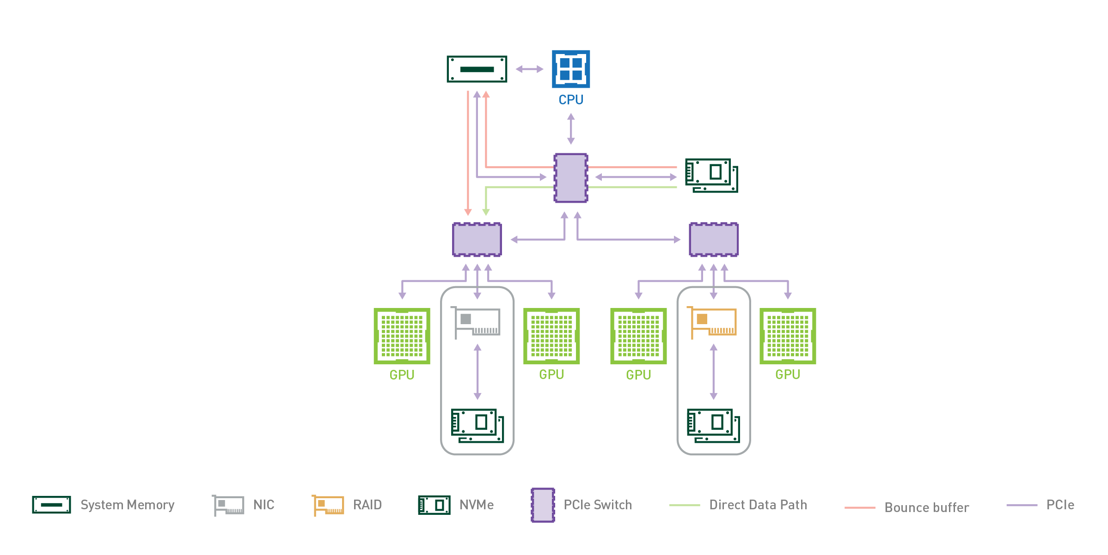
NVIDIA GPUDirect Storage
Direct data path between GPU memory and storage
cuFile APIs and cuDF library
Client software running on GPUs
PFS client software
NFS over RDMA
OceanStor A310, NFS/RDMA, 80GBps/RU
Notes:
Huawei NoF capability paves the road to support GDS

Slide 17
Competitive Landscape
AI/ML Infrastructure
Ransomware Protection
Disaggregated Composable
Big Data Analytics
Hybrid Multi-Cloud
Product Evolution
Notes:
Highlight: these are the most relevant technology to data centers.

Slide 18
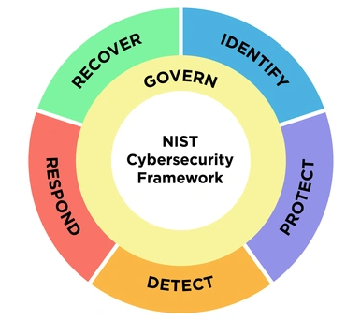
Technology Trends in Ransomware Protection
Physical and logical air gaps
ML-based anomaly detection
Immutable snapshots and clock
Frequent regular snapshots (RPO)
Flash landing zone for fast backups & restores
Instant recovery (RTO)
Multi-dimensional, multi-layered solution
Notes:
Huawei NoF capability paves the road to support GDS

Slide 19
Competitive Landscape
AI/ML Infrastructure
Ransomware Protection
Disaggregated Composable
Big Data Analytics
Hybrid Multi-Cloud
Product Evolutions
Notes:
Highlight: these are the most relevant technology to data centers.

Slide 20
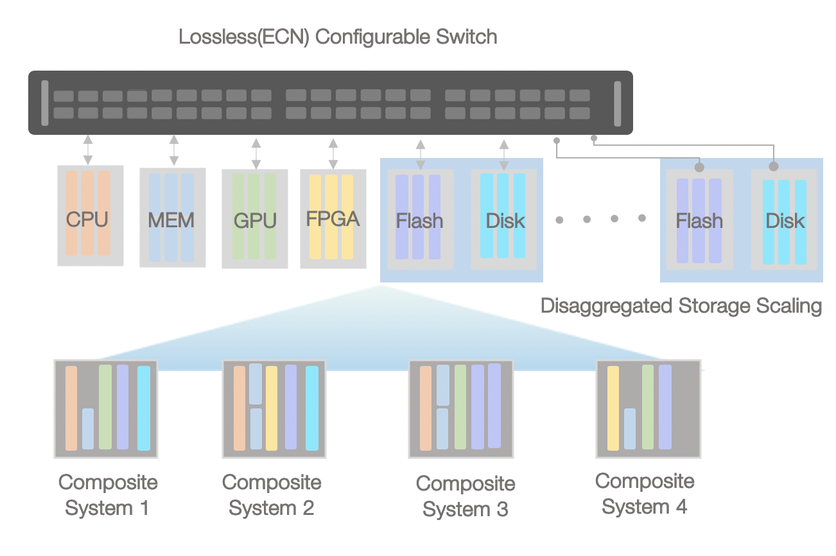
Disaggregated, Composable Infrastructure
Compose and match resources to application demands
Eliminate stranded resources
Increase utilization, reduce costs
Improve performance
Accelerate the introduction of new media, accelerators
Notes:
Huawei NoF capability paves the road to support GDS

Slide 21
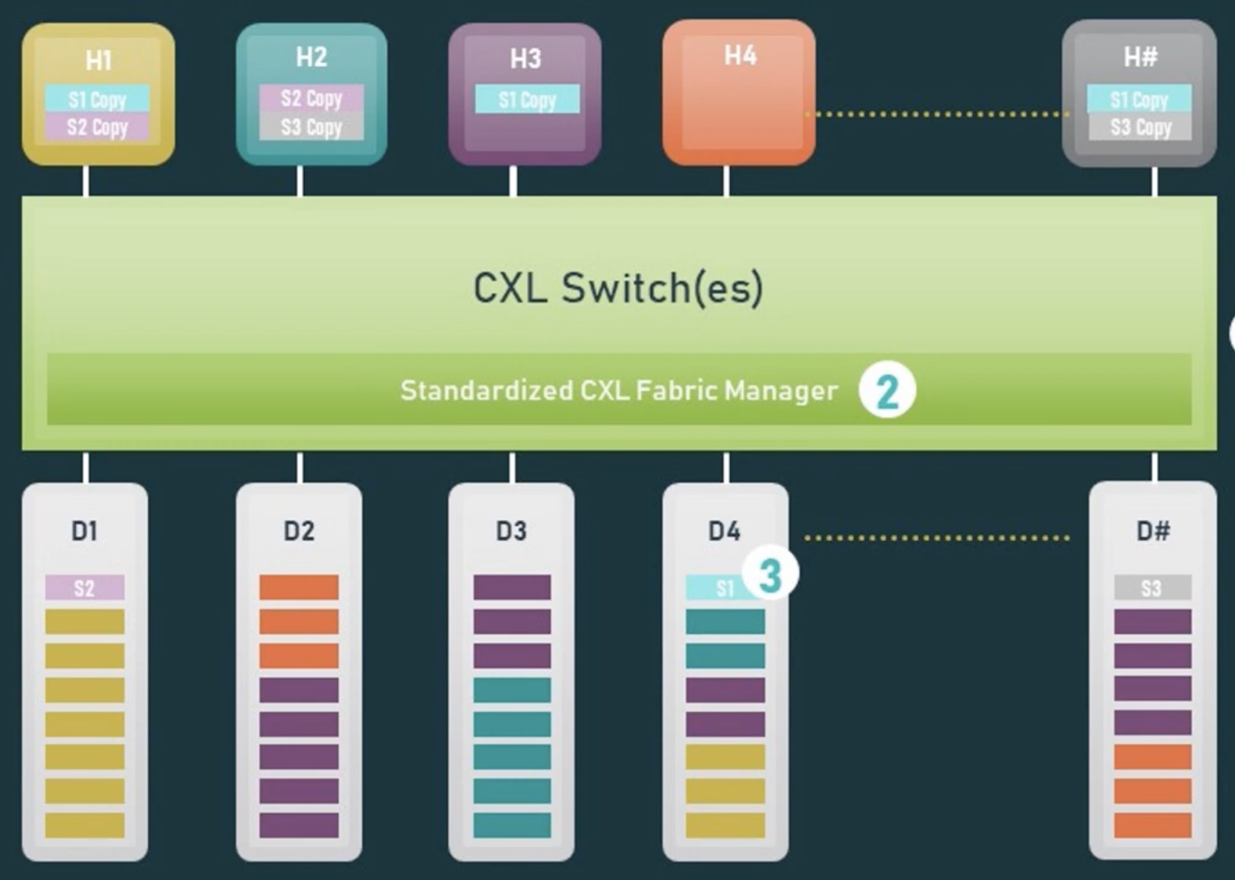
Compute Express Link
Technology
PCIe physical layer
Low-latency memory access
Multi-host, rack scale
Wide industry support
Use Cases
Memory expansion
Memory pooling
Memory sharing
Memory semantic SSDs
Notes:
Huawei NoF capability paves the road to support GDS

Slide 22
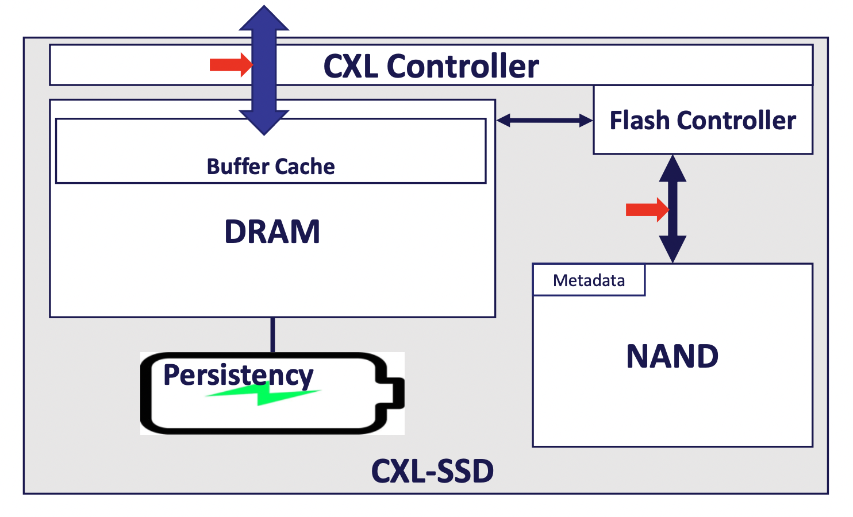
Memory Semantic SSDs
Persistent Memory Mode
CXL.mem access to persistent DRAM
DRAM caching for NAND
Persistent flush to NAND
Dual Access Mode
CXL.mem access to DRAM
CXL.io access to NAND
Notes:
Huawei NoF capability paves the road to support GDS

Slide 23
Competitive Landscape
AI/ML Infrastructure
Ransomware Protection
Disaggregated Composable
Big Data Analytics
Hybrid Multi-Cloud
Product Evolutions
Notes:
Highlight: these are the most relevant technology to data centers.

Slide 24
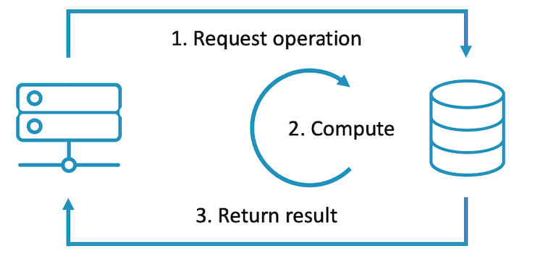
Near Storage Compute
Analytical & transactional queries
Ingest row data to columnar tables
SQL, S3, NFS, SMB access
Perform queries near storage
3rd-party analytics application plug-ins
Vector database search
Deep Learning Recommendation Engine (DLRE)
Distribute vector search to multiple memory/storage devices
Notes:
Huawei NoF capability paves the road to support GDS

Slide 25
Competitive Landscape
AI/ML Infrastructure
Ransomware Protection
Disaggregated Composable
Big Data Analytics
Hybrid Multi-Cloud
Product Evolutions
Notes:
Highlight: these are the most relevant technology to data centers.

Slide 26
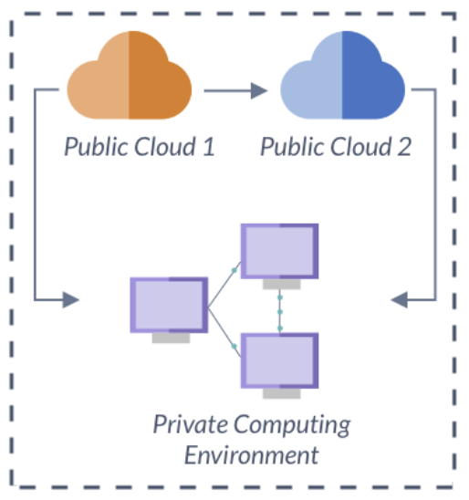
Hybrid Multi-Cloud Infrastructure
Cloud Archive
Most popular cloud use case
Cloud Tiering
Reduce cloud egress costs, no 3rd-party software
Cloud File System
Local cache, multi-site collaborations
Global File System
On-prem and cloud storage
Global namespace, metadata replication
Data services – search, versioning, tiering, …
Notes:
Huawei NoF capability paves the road to support GDS

Slide 27
Competitive Landscape
AI/ML Infrastructure
Ransomware Protection
Disaggregated Composable
Big Data Analytics
Hybrid Multi-Cloud
Product Evolutions
Notes:
Highlight: these are the most relevant technology to data centers.

Slide 28
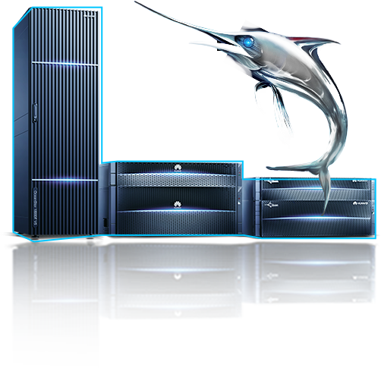
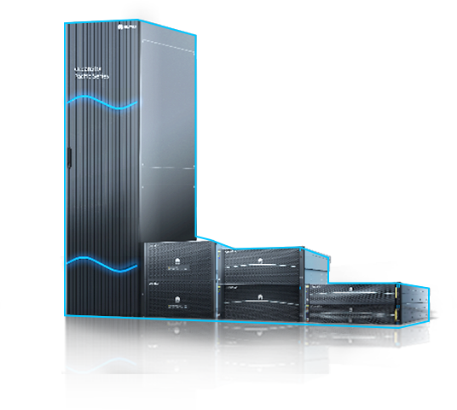
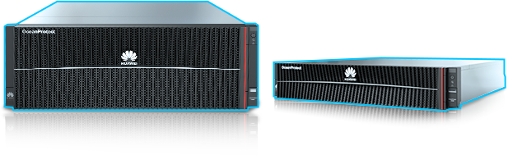

Product Evolutions
Key Features in 2023
Evolution in 2024
Best Container Base
Cross-site K8s DR, heterogeneous NAS migration, E2E NAS data mobility, etc.
Disaggregated Architecture
Composable, shared memory architecture, 50% performance increase
OceanStor Dorado V6
Tiering Data in All scenarios
Tiering to cloud, cross-pool online volume migration, data flow between clusters, etc.
AI/ML Performance and Scalability
OceanStor A310, 80GBps/RU, 200G RoCE access
Global File System
OceanStor Pacific
Ransomware Protection
Ransomware detection & analysis, backup tiering, deduplication capability enhancement, etc.
More Affordable Flash Landing Zone
Global deduplication, source deduplication capability enhancement, tiering to pacific after deduplication.
OceanProtect
Scenario-centric Mgmt
Comprehensive ransomware protection mgmt., Unified mgmt. of K8S, Unified DR mgmt etc.
Intelligent O&M
E2E intelligent performance diagnosis from VM to storage, security & health assessment by AI, etc.
Data Management Engine
Notes:
Huawei NoF capability paves the road to support GDS

Slide 29
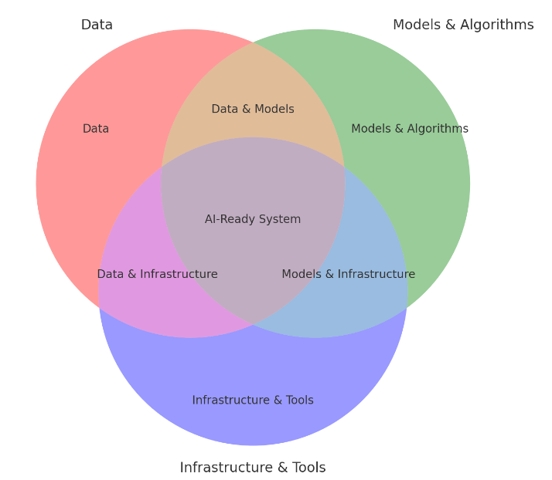
AI Ready System Essentials
Data is the foundation of any AI system. This includes structured and unstructured data that the AI can learn from. Quality, quantity, and diversity of data are crucial to the effectiveness of an AI system.
Models & Algorithms represents the core AI/ML models and algorithms that process data to generate insights. It includes machine learning techniques, deep learning models, and optimization algorithms.
Infrastructure & Tools includes the computational resources, frameworks, and software tools required to deploy and scale AI systems. Cloud services, GPUs, orchestration tools, and model serving platforms are part of this aspect.
Notes:
Data :
Components: Model training, selection of algorithms, evaluation, tuning, and deployment.
Importance: This aspect focuses on building and refining models to ensure accurate predictions, classifications, or actions based on the data.
Models & Algorithms
Components: Model training, selection of algorithms, evaluation, tuning, and deployment.
Importance: This aspect focuses on building and refining models to ensure accurate predictions, classifications, or actions based on the data.
Infrastructure & Tools
Components: Storage platform like Oceanstor Pacific hardware (GPUs/TPUs), NVMe drives , DevOps practices, and AI/ML frameworks (TensorFlow, PyTorch, etc.).
Importance: Ensures that the AI models are scalable, resilient, and integrated with the existing system for deployment in real-world applications.

Slide 30


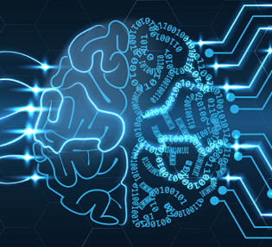
Advancements In AI Storage
AI-Powered Storage Management
Multimodal AI
Smaller Language Models
Automated data placement and optimization
Predictive analytics for storage capacity and performance
Intelligent data tiering based on access patterns and value
Enhanced data security through AI-driven anomaly detection
More intuitive and versatile AI applications in storage management
Enhanced data analysis capabilities across various formats (text, image, video)
Improved data retrieval and organization
.
Reduced resource requirements for model training and inference
Improved energy efficiency and cost-effectiveness
Enhanced explainability and transparency in AI decision-making
.
Notes:
https://www.linkedin.com/pulse/10-largest-ai-powered-storage-companies-2024-premium-insight-vw0zf/
https://news.northeastern.edu/2024/07/16/ai-data-storage-cloud/
https://siliconangle.com/2024/08/16/hybrid-environments-ai-evolution-of-storage-aihardwareandinfrastructure/
https://www.micron.com/about/blog/storage/insights/2024-predictions-in-storage-technology-and-the-world-part-1-the-ai-hype-is-real

Slide 31
Emerging Trends In AI Storage
Edge AI Storage
Growing focus on optimizing storage for AI workloads at the edge
Enables real-time processing and reduces latency for IoT and mobile AI applications
Green AI Storage
Increasing focus on energy-efficient AI storage solutions
Addresses the growing environmental concerns associated with large-scale AI deployments
Quantum Machine Learning
Exploration of quantum computing for AI storage and processing.
Promises unprecedented computational power for certain AI tasks
Customized Local Models & Data Pipelines
Utilization of open-source models as a foundation & fine tuning with proprietary data
Implementation of local data pipelines for enhanced security and performance
Cognitive Search and Content Management
AI-driven search and content management solutions providing more accurate and context-aware results
Enhances data discovery and utilization in large, complex datasets
AI-Optimized Hardware-Software Co-design
Closer integration between hardware and software components in AI storage systems
Improves overall system efficiency and performance
Notes:
https://www.ibm.com/think/insights/artificial-intelligence-trends
https://devabit.com/blog/top-11-new-technologies-in-ai-exploring-the-latest-trends/
https://explodingtopics.com/blog/data-storage-trends
https://aithority.com/it-and-devops/cloud/10-ai-ml-in-data-storage-trends-to-look-out-for-in-2024/

Slide 32
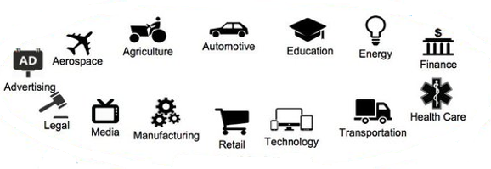
AI Storage Adoption
AI-powered storage solutions are being adopted across a wide range of industries, each leveraging the technology to address specific challenges and optimize operations
Notes:
https://solguruz.com/blog/use-cases-of-ai-revolutionizing-industries/
https://www.forbes.com/advisor/business/software/ai-in-business/
https://connect.comptia.org/blog/artificial-intelligence-statistics-facts

Slide 33
Huawei's Competitive Advantages
Focus on High-Performance Computing
Solutions are tailored for demanding AI and analytics applications
Integrated AI Capabilities
Incorporates AI throughout its storage solutions, enhancing efficiency and performance.
Global Market Reach
International presence allows it to cater to diverse market needs and gain insights from various industries.
.
Research and Development
Significant investments in R&D to stay at the forefront of AI and storage technologies.
End-to-End Solutions
Offers comprehensive AI and storage solutions, from hardware to software and services.
Notes:
https://www.moroccoworldnews.com/2024/04/362292/huawei-unveils-three-innovative-data-storage-solutions-for-the-ai-era

Slide 34
AI Storage Ecosystem Essentials
HARDWARE
High-Performance Compute Resources
Storage Devices
Networking Infrastructure
Specialized AI Hardware
SOFTWARE
Data Processing Frameworks
Machine Learning Frameworks
AI-Optimized File Systems
MLOps Platforms
AI-Driven Storage Management
Deduplication & Compression
DATA MANAGEMENT
Automated Data Classification
Intelligent Data Cataloging
Data Quality Enhancement
Predictive Data Lifecycle Management
Automated Data Integration
DATA SECURITY
AI-Enhanced Threat Detection
Automated Access Control
Data Encryption
Compliance Management
Secure Multi-tenancy
CLOUD SERVICES INTEGRATON
Multi-cloud AI Storage
Cloud-native AI Services
Serverless AI Computing
AI-Driven Storage Optimization
Global Data Accessibility
Notes:
https://victorycto.com/assessing-the-profound-impact-of-ai-on-data-management-strategies/
https://sloanreview.mit.edu/article/how-ai-is-improving-data-management/
https://aithority.com/it-and-devops/cloud/10-ai-ml-in-data-storage-trends-to-look-out-for-in-2024/
https://thenewstack.io/the-architects-guide-to-storage-for-ai/
https://www.run.ai/guides/machine-learning-engineering/ai-infrastructure
https://www.netapp.com/artificial-intelligence/

